Slide 1


Slide 2
Final YEAR PROJECT
Requirement Specifications Document

Slide 3

Mr. CHEF
Your Kitchen Assistant
Supervisor: Dr. Hammad Afzal

Slide 4
SYNDICATE
NC Muhammad Mohsin Zafar
NC Muhammad Sufyan
NC Muhammad Awab

Slide 5
OUTLINE
Introduction
Problem Statement
Project as Solution
Overall Description
Product Perspective
Key Areas
Component Diagram
Operating Environment
Assumptions & Constraints
Requirements
Context Diagram
Use Case Diagram
Functional Requirements
Non Functional Requirements
User Interfaces
Timeline
Q/A Session

Slide 6
Introduction – Problem Statement
With everyday technological advancements and continual automation of existing processes, may it be an industrial process or one’s home, there is no binding to work that is being done to replace human activity by mechanical activity. So, following the trend we want to take automation into one’s home and specifically kitchens
Today, in this modern era; in a family, earning members are not just limited to males but females are equally participating. They either take much burden by both keeping the housework in check and their jobs or a servant is hired to take care of the house and related tasks. One such task is the work in Kitchen which becomes much of headache for a working woman

Slide 7
Introduction – Project as Solution
Keeping the problem statement in mind, we intend on developing a robotic system that shall automate daily kitchen work at home as much as possible. The system shall be an assistant to the user
The system shall also feature “IoT” implementation which shall remove the user’s need for presence on site for task initiation. It shall not matter whether your are at home or not
Let’s say you're bringing home some friends and there is no one at home to cook food for them, wait! Our project is the solution!

Slide 8
Overall Description - Product Perspective
The idea of the project is to realize implementation of robotic arm(s) that shall carry out activities related to cooking in kitchen, approximately same as a human would do with task initiation done by the user thus providing a semi-autonomous system to automate kitchen tasks as much as possible. The goal is to take home automation a step further
Reference: “Requirement Specification Document for MR. CHEF – Your Kitchen Assistant “ - Page: 7

Slide 9
Overall Description – Key Areas
An Android Application providing an interface to user for interacting with robotic system
Connection of Android Application to Raspberry Pi over the internet
Object Identification by Raspberry Pi using a Camera
Control of Robotic Arms’ Movements by Raspberry Pi via Arduino
Use of Camera by Raspberry Pi after fixed intervals to verify status of meal being cooked.
Reference: “Requirement Specification Document for MR. CHEF – Your Kitchen Assistant “ - Page: 8

Slide 10
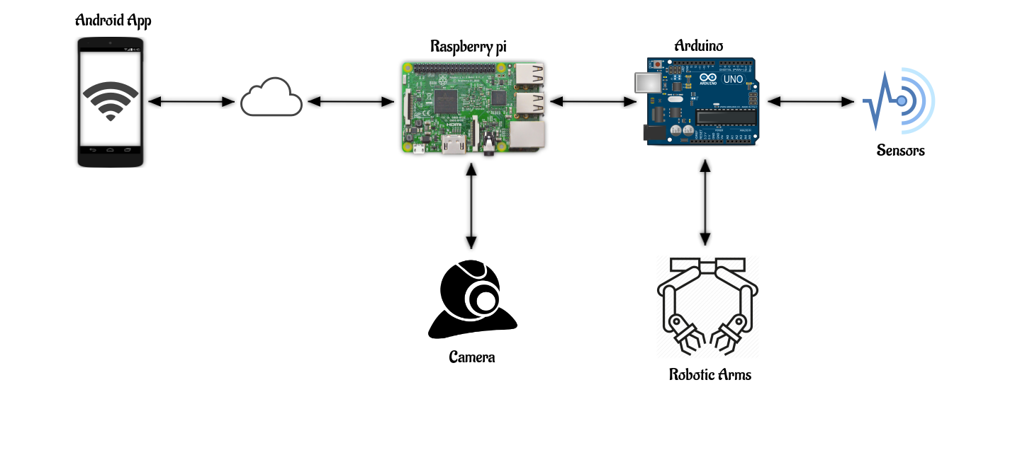
Component Diagram
Reference: “Requirement Specification Document for MR. CHEF – Your Kitchen Assistant “ - Page: 8

Slide 11
Operating Environment
Environment
Hardware
Software
Reference: “Requirement Specification Document for MR. CHEF – Your Kitchen Assistant “ - Page: 9-10

Slide 12
Assumptions & Constraints

Slide 13
Assumptions & Constraints
Network Dependency
Known Environment
Payload Weight Limitation
Critical Temperature
Non Detection of Dislocated Objects
Usage of Induction Stove
Specific format for Add New Recipe
Prototype Constraint on Add New Recipe
Reference: “Requirement Specification Document for MR. CHEF – Your Kitchen Assistant “ - Page: 10-12

Slide 14
Assumptions & Constraints
Continuous Power Supply
Prototype Constraint on Robotic Arm(s)
Camera Resolution
Unique ID & Verification
Reference: “Requirement Specification Document for MR. CHEF – Your Kitchen Assistant “ - Page: 10-12

Slide 15
Requirements
Functional & Non Functional

Slide 16
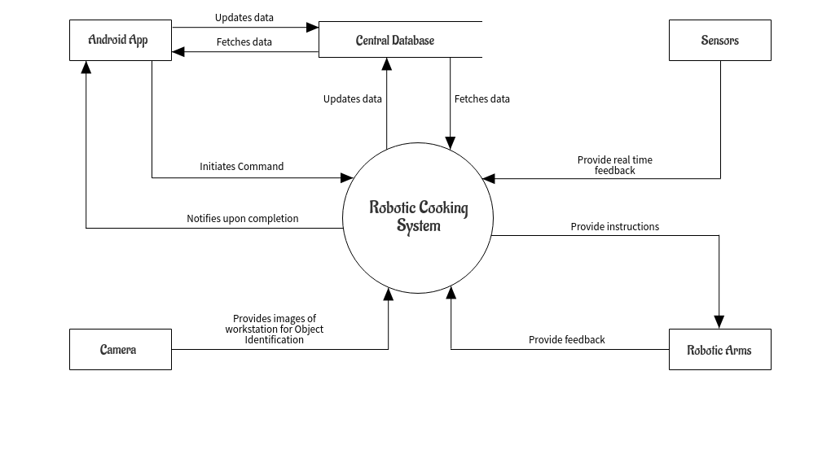
Context Diagram
Reference: “Requirement Specification Document for MR. CHEF – Your Kitchen Assistant “ - Page: 17

Slide 17
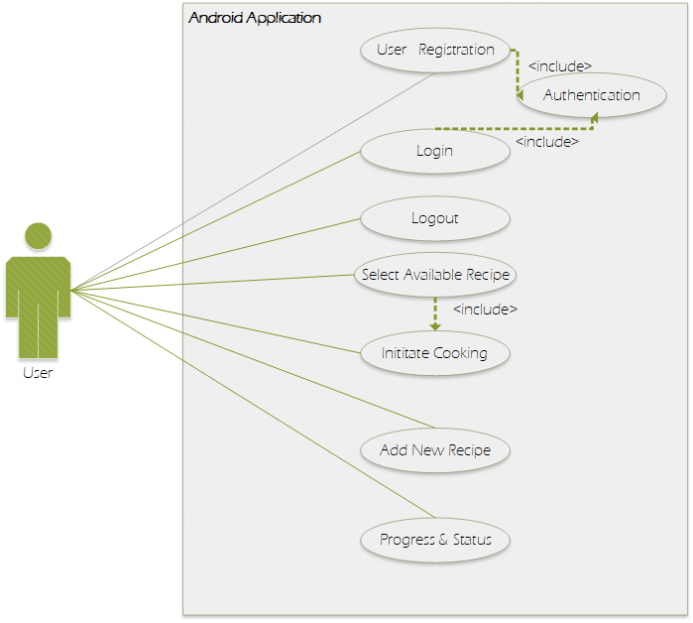
Use Case Diagram
Reference: “Requirement Specification Document for MR. CHEF – Your Kitchen Assistant “ - Page: 17

Slide 18
Functional Requirements – Organized Based on System Features
User Registration
REQ-1 The Application shall enable user to get himself/herself register with the System.
REQ-2 The Application shall take User’s credentials including Name, Email address & a Password, and a Unique Identification Number for the product; as input.
REQ-3 The Application shall authenticate user’s input data by matching verification code with System’s database.
REQ-4 Only, in case of successful Authentication, the application shall take user to the Home Screen.
REQ-5 In case, user signs out of the application, user shall only be able to use Application’s functionality once user has signed back into the application after providing email address & password, as input to the application.
Reference: “Requirement Specification Document for MR. CHEF – Your Kitchen Assistant “ - Page: 18-19

Slide 19
Functional Requirements – Organized Based on System Features
Selection From Available Recipes
REQ-6 The Application shall present user with a List of All Available Recipes if and when user clicks on the button of “Available Recipes” while at Home Screen.
REQ-7 The Application shall allow user to select only one Recipe from the list.
REQ-8 The Application shall enable/show a button, “Initiate Cooking” upon successful selection of Recipe by the user.
REQ-9 The Application shall send command to Raspberry Pi via Internet to Initiate the Cooking of Selected Recipe, when user clicks on “Initiate Cooking” button,
REQ-10 After the initiate cooking command has been send to Raspberry Pi, the Application shall take user to the Progress and Status Screen.
Reference: “Requirement Specification Document for MR. CHEF – Your Kitchen Assistant “ - Page: 19-21

Slide 20
Functional Requirements – Organized Based on System Features
Addition of New Recipes
REQ-11 The Application shall take user to “Add New Recipe” Screen, when user clicks on “Add New Recipe” button while at Home Screen.
REQ-12 The application shall ask user for a unique Recipe Name.
REQ-13 The Application shall ask user to Add Ingredients and their quantity.
REQ-14 The Application shall allow user to select ingredients only that are already listed in the system.
REQ-15 The Application shall ask user to select utensils and crockery from list of available utensils and crockery.
Reference: “Requirement Specification Document for MR. CHEF – Your Kitchen Assistant “ - Page: 21-23

Slide 21
Functional Requirements – Organized Based on System Features
Addition of New Recipes
REQ-16 The Application shall ask user to add steps for recipe, using only the keywords provided in Application.
REQ-17 The Application shall check for validity of added steps in REQ-16.
REQ-18 The Application shall prompt user to “Add” or “Cancel”, in case of successful validation of entered steps.
REQ-19 The Application shall add newly entered recipe to list of available recipes.
Reference: “Requirement Specification Document for MR. CHEF – Your Kitchen Assistant “ - Page: 21-23

Slide 22
Functional Requirements – Organized Based on System Features
Image Acquisition
REQ-20 The system shall be able to acquire images of workstation in real time for further processing.
Reference: “Requirement Specification Document for MR. CHEF – Your Kitchen Assistant “ - Page: 23-24

Slide 23
Functional Requirements – Organized Based on System Features
Identification of Objects
REQ-21 The system shall be able to identify objects that are placed on the workstation where objects include; ingredients, cutlery, utensils & stove.
REQ-22 The system shall be able to distinguish objects that are specific to Recipe under progress, from all identified objects.
Reference: “Requirement Specification Document for MR. CHEF – Your Kitchen Assistant “ - Page: 24-25

Slide 24
Functional Requirements – Organized Based on System Features
Control of Robotic Arm(s)
REQ-23 The system shall be able to effectively control Robotic Arm(s) to perform tasks as per the recipe.
REQ-24 The system shall notify user via Android Application after successful completion of all task as per the recipe.
Reference: “Requirement Specification Document for MR. CHEF – Your Kitchen Assistant “ - Page: 25-26

Slide 25
Functional Requirements – Organized Based on System Features
Acquisition of Feedback from Sensors
REQ-25 The system shall be able to acquire feedback from Proximity Sensor, Ultrasonic Sensor & Temperature sensor to ensure effective continuation of tasks by Robotic Arm(s).
Reference: “Requirement Specification Document for MR. CHEF – Your Kitchen Assistant “ - Page: 27-28

Slide 26
Functional Requirements – Organized Based on System Features
Progress Status of Cooking
REQ-26 The system shall take snaps of Cooking Pan while it has been placed on Stove after regular intervals (ranging from 15-30 seconds) to determine whether cooking task has completed or achieved desirous state before moving to next step or notifying application of completion.
Reference: “Requirement Specification Document for MR. CHEF – Your Kitchen Assistant “ - Page: 28-29

Slide 27
Functional Requirements – Organized Based on System Features
Homing
REQ-27 The system shall command robot arms(s) to return to original/initial state after every single step of the recipe completes.
Reference: “Requirement Specification Document for MR. CHEF – Your Kitchen Assistant “ - Page: 29-30

Slide 28
Non Functional Requirements
Availability
Relibality
NFR-1 The system shall always be available to receive command from the user and to start cooking.
NFR-2 The Android Application shall always show latest and up to date List of Available Recipes.
Reference: “Requirement Specification Document for MR. CHEF – Your Kitchen Assistant “ - Page: 30

Slide 29
Non Functional Requirements
Maintainability
Security
NFR-3 The system shall use standard sensors & electrical components available in market which may be replaced in case of component failure.
NFR-4 User Interface shall be independent of the back-end code responsible for interacting with hardware components therefore allowing changes to be done in either of the codes without affecting the other.
NFR-5 Android Application shall not allow user to use application or system features unless registered and signed in.
NFR-6 The application shall not require user to sign into the application each time except for the first time unless user signs out.
Reference: “Requirement Specification Document for MR. CHEF – Your Kitchen Assistant “ - Page: 30-31

Slide 30
Non Functional Requirements
Environmental
Legal
NFR-7 The system shall use induction stove therefore reducing environmental damage caused by gas stoves.
NFR-8 System shall adhere to public food and health safety standards.
Reference: “Requirement Specification Document for MR. CHEF – Your Kitchen Assistant “ - Page: 31

Slide 31
Non Functional Requirements
Usability
The graphical user interface of system shall be designed with usability as the priority. The app will be presented and organized in a manner that is both visually appealing and easy for the user to navigate.
The user shall be able to use application with a maximum of three training sessions.
User guide shall be provided within the Android Application.
Reference: “Requirement Specification Document for MR. CHEF – Your Kitchen Assistant “ - Page: 31

Slide 32
User Interfaces

Slide 33

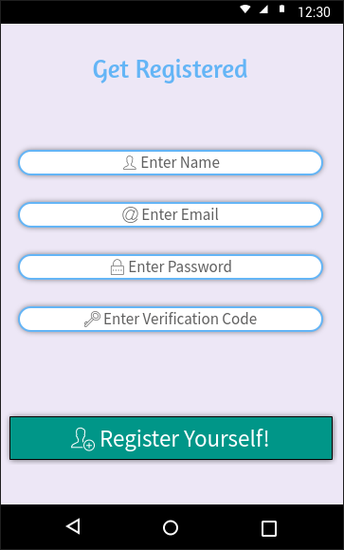
Android Application’s Interfaces
Reference: “Requirement Specification Document for MR. CHEF – Your Kitchen Assistant “ - Page: 13-15

Slide 34
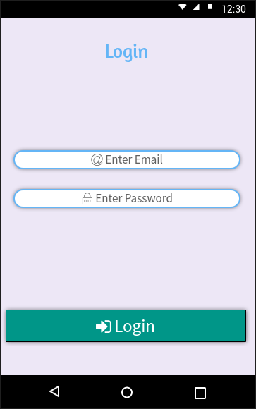
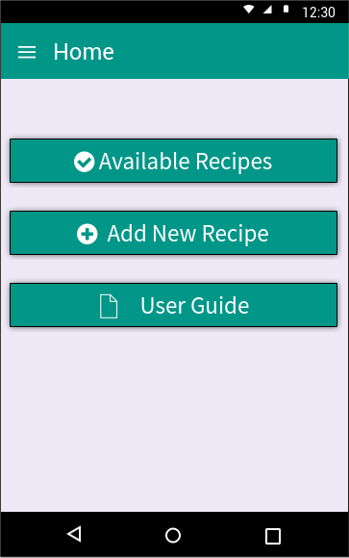
Android Application’s Interfaces
Reference: “Requirement Specification Document for MR. CHEF – Your Kitchen Assistant “ - Page: 13-15

Slide 35
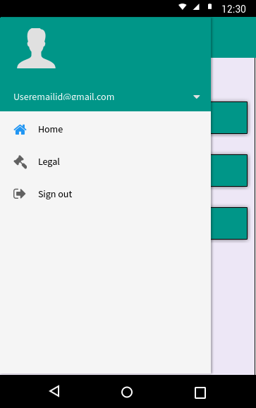
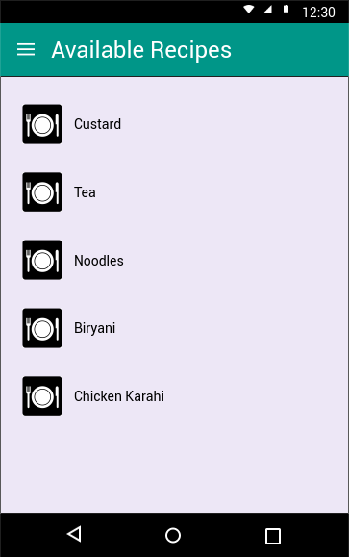
Android Application’s Interfaces
Reference: “Requirement Specification Document for MR. CHEF – Your Kitchen Assistant “ - Page: 13-15

Slide 36
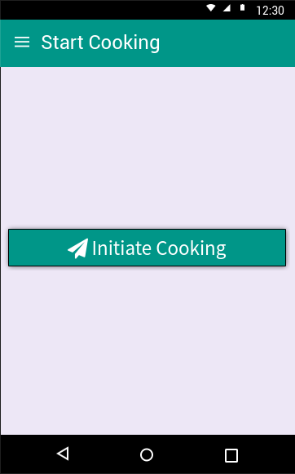
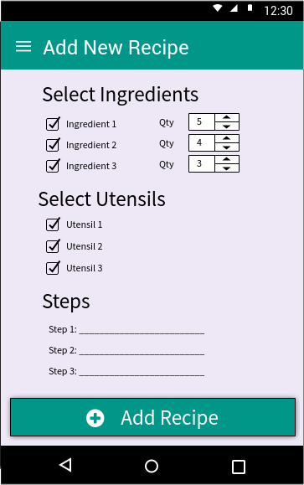
Android Application’s Interfaces
Reference: “Requirement Specification Document for MR. CHEF – Your Kitchen Assistant “ - Page: 13-15

Slide 37
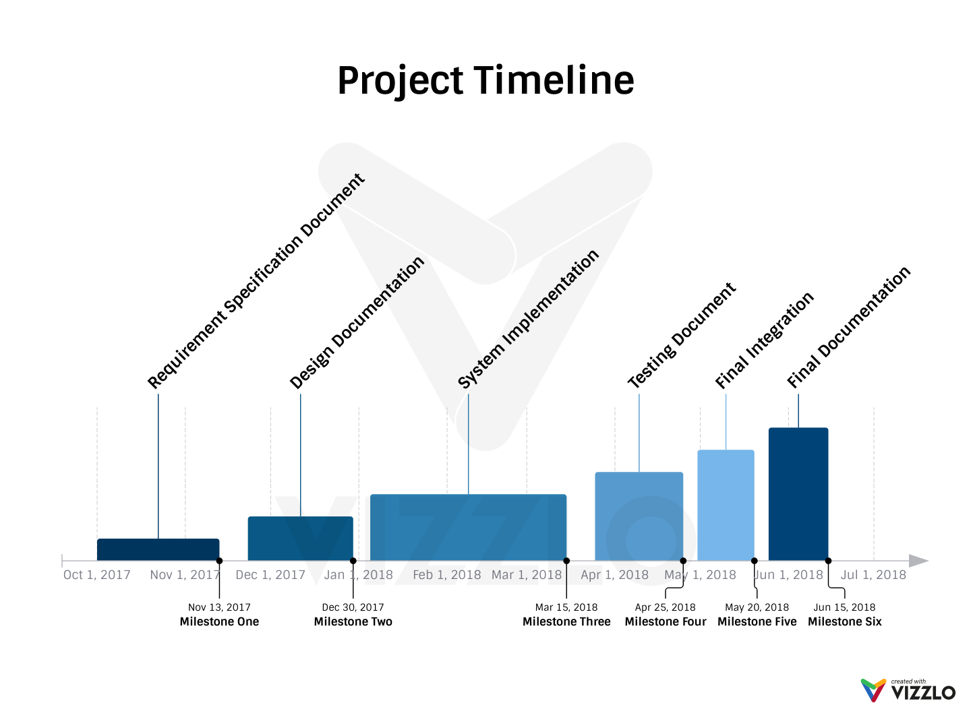
Project Timeline

Slide 38

Q/A Session
Any Queries?

Slide 39

Thank You!

